Slide 1



DataTable Scripting Functions
NHS Automation Team

Slide 2
Data table
DataTable Scripting Functions
Two types of data table are available :
1. Global data sheet: Accessible to all actions in the Test
2. Local data sheet: Accessible to the associated action only
Usage:
For Global data sheet, DataTable("Column Name",dtGlobalSheet) or
DataTable("Column Name“)
For Local data sheet, DataTable("Column Name",dtLocalSheet)

Slide 3
Data table scripting functions
DataTable Scripting Functions
Method | Purpose | Syntax
GetSheetCount | Gets the Number of Sheets in the DataTable | DataTable.GetSheetCount
GlobalSheet | Returns the First sheet in the run time datatable(global sheet) | DataTable.GlobalSheet
LocalSheet | Returns the current (active) local sheet of the run-time Data Table. | DataTable.LocalSheet

Slide 4
Data table scripting functions
DataTable Scripting Functions
Method | Purpose | Example
AddSheet | Adds the specified sheet to the run-time Data Table and returns the sheet so that you can directly set properties of the new sheet in the same statement. | DataTable.AddSheet(SheetName)
DeleteSheet | Deletes the specified sheet from the run-time Data Table. | DataTable.DeleteSheet SheetID

Slide 5
Data table scripting functions
DataTable Scripting Functions
Method | Purpose | Example
Export | Saves a copy of the run-time Data Table in the specified location. | DataTable.Export(FileName)
ExportSheet | Exports a specified sheet of the run-time Data Table to the specified file. | DataTable.ExportSheet(FileName, DTSheet)
GetCurrentRow | Returns the current (active) row in the first sheet in the run-time Data Table (global sheet). | DataTable.GetCurrentRow

Slide 6
Data table scripting functions
DataTable Scripting Functions
Method | Purpose | Example
GetRowCount | Returns the total number of rows in the longest column in the first sheet in the run-time Data Table (global sheet). | DataTable.GetRowCount
Raw Value | Retrieves the raw value of the cell in the specified parameter and the current row of the run-time Data Table. The raw value is the actual string written in a cell before the cell has been computed, such as the actual text from a formula. | DataTable.RawValue ParameterID [, SheetID]

Slide 7
Data table scripting functions
DataTable Scripting Functions
Method | Purpose | Example
Import | Imports the specified Microsoft Excel file to the run-time Data Table. | DataTable.Import(FileName)
ImportSheet | Imports a sheet of a specified file to a specified sheet in the run-time Data Table. The data in the imported sheet replaces the data in the destination sheet (see SheetDest argument). | DataTable.ImportSheet(FileName, SheetSource, SheetDest)

Slide 8
Data table scripting functions
DataTable Scripting Functions
Method | Purpose | Example
SetCurrentRow | Sets the specified row as the current (active) row in the run-time Data Table. | DataTable.SetCurrentRow(RowNumber)
Value | DataTable default property. Retrieves or sets the value of the cell in the specified parameter and the current row of the run-time Data Table. | DataTable.Value(ParameterID [, SheetID])

Slide 9
Data table scripting functions
DataTable Scripting Functions
Method | Purpose | Example
SetNextRow | Sets the row after the current (active) row as the new current row in the run-time Data Table. | DataTable.SetNextRow
SetPrevRow | Sets the row above the current (active) row as the new current (active) row in the run-time Data Table. | DataTable.SetPrevRow
GetSheet | Returns the specified sheet from the run-time Data Table. | DataTable.GetSheet(SheetID)

Slide 10
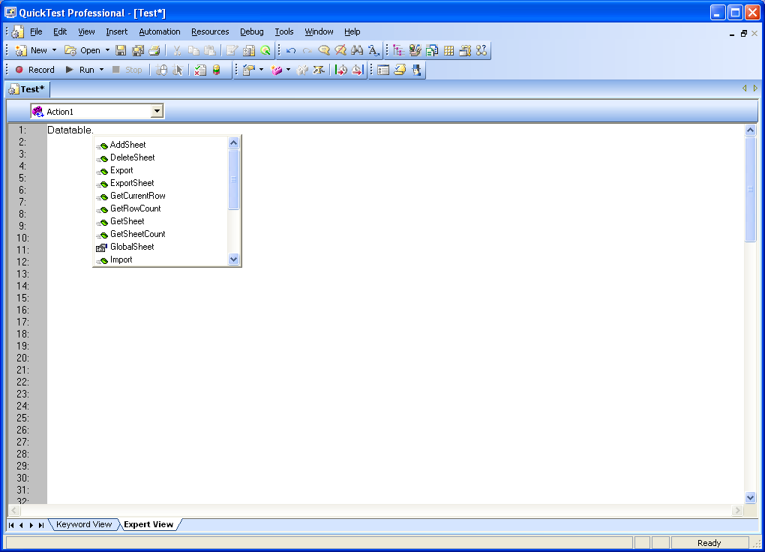
Example1
DataTable Scripting Functions
Export method- Saves a copy of the run-time Data Table in the specified location.
Syntax: DataTable.Export(FileName)
DataTable.Export(“D:\scenario1.xls”)

Slide 11
Example2
DataTable Scripting Functions
Import method- Imports the specified Microsoft Excel file to the run-
time Data Table. The imported table must match the test or
component. The column names must match the parameters in the test
or component, and the sheet names (for tests) must match the action
names.
DataTable.Import ("C:\flights.xls")
GetRowCount Method-Returns the total number of rows in the longest column in the first sheet in the run-time Data Table
rowcount = DataTable.GetSheet("MySheet").GetRowCount

Slide 12
Summary of the Topics Covered
Working with Actions
DataTable
Data Scripting Functions
Examples
Questions?

Slide 13

Thank You

